Slide 1
I am the bread of life

Slide 2
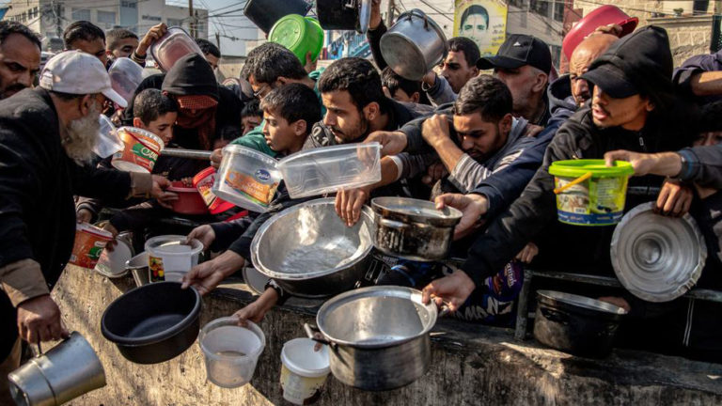
Starvation in our World
This Photo by Unknown Author is licensed under CC BY-SA

Slide 3

Starvation in our Souls

Slide 4
I am the bread of life. . .
I am the living bread that came down from heaven. Whoever eats of this bread will live forever; and the bread that I will give for the life of the world is my flesh.
I

Slide 5
Consider the nature of BREAD
Satisfying hunger

Slide 6
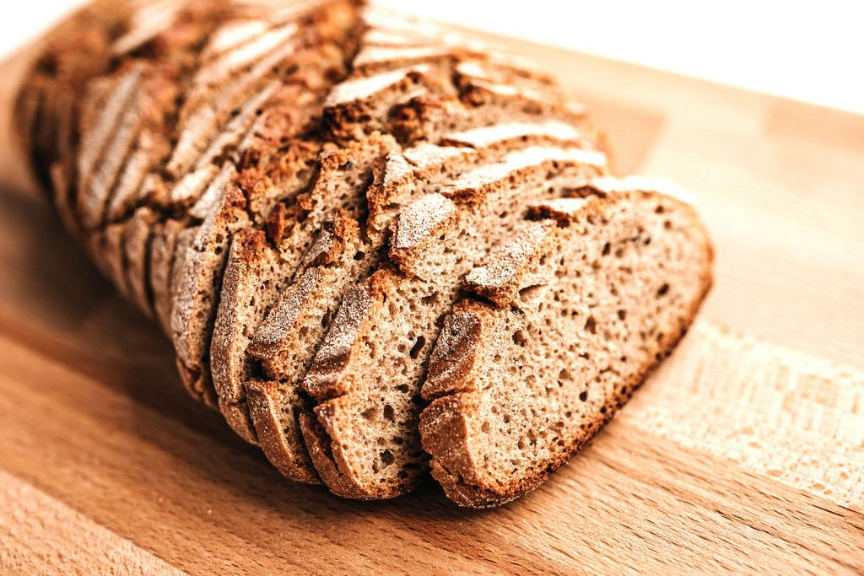
Food as Fuel eating to live
This Photo by Unknown Author is licensed under CC BY

Slide 7

Pleasure Eating
This Photo by Unknown Author is licensed under CC BY-SA-NC
Living to Eat

Slide 8

Boredom Eating
Mindless snacking as we are otherwise occupied
This Photo by Unknown Author is licensed under CC BY

Slide 9
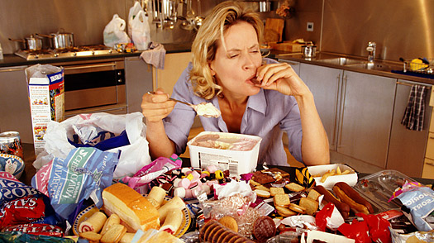
Emotional Eating
This Photo by Unknown Author is licensed under CC BY

Slide 10
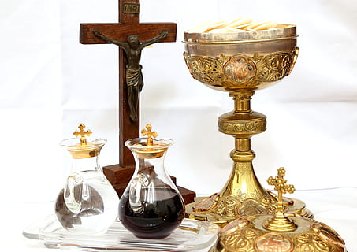
Sacrament of the Eucharist

Slide 11
Feed the Starving
Physical Hunger
Spiritual Hunger
Donate to our local food shelves
Donate to international aid organisations
Pray for Peace
Participate in activism
Develop daily habits of prayer
Recognise God in beauty
Practice mindfulness and meditation
Be open to the comfort and guidance of the Spirit

