Slide 1
COMPASSION
INDIVIDUAL ACTS OF COMPASSION
CHANGE EVERYTHING

Slide 2
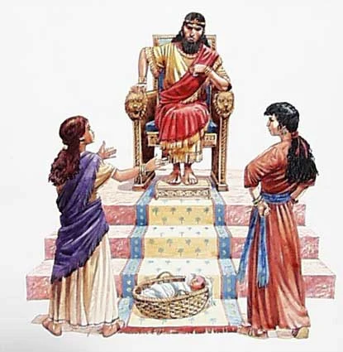
SOLOMON’S JUDGEMENT
Depends on the compassion of the woman
System of justice tempered by compassion
Wisdom of Solomon relies on God-given maternal love

Slide 3
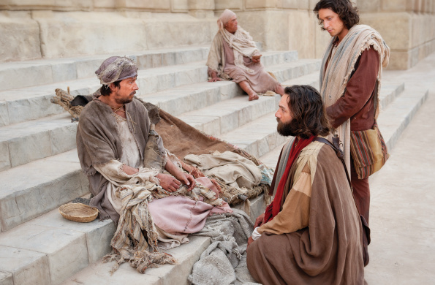
Peter & John Encounter Beggar

Slide 4
⁴ Peter looked intently at him, as did John, and said, ‘Look at us.’ ⁵ And he fixed his attention on them, expecting to receive something from them. ⁶ But Peter said, ‘I have no silver or gold, but what I have I give you; in the name of Jesus Christ of Nazareth,^{[a]}stand up and walk.’ ⁷ And he took him by the right hand and raised him up; and immediately his feet and ankles were made strong. ⁸ Jumping up, he stood and began to walk, and he entered the temple with them, walking and leaping and praising God.

Slide 5
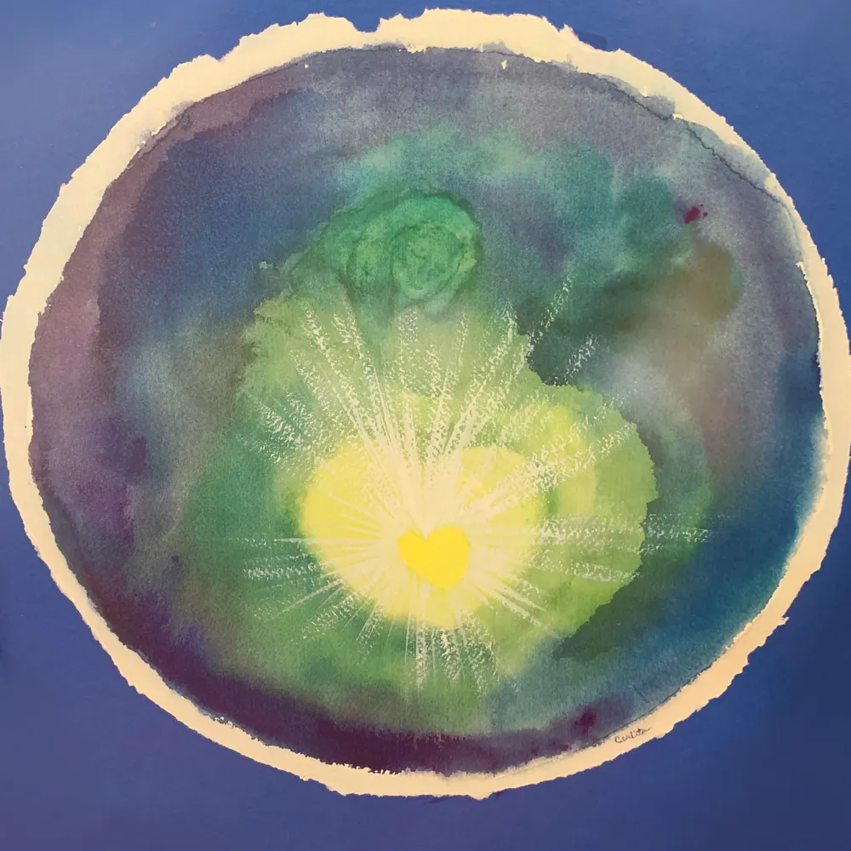
Jesus is Compassion Incarnate

Slide 6
Compassionate Acts
Toward his disciples — you need rest and food
Toward the aimless people — you need direction and education
Toward the hungry multitudes — you need food
Toward his disciples in the storm — you need reassurance and calm seas

Slide 7

Compassion to Everybody, Anybody

